Slide 1
TNGS Learning Solutions CLOUD COMPUTING INTRODUCTION TO AWS

Slide 2
INTRODUCTION TO CLOUD COMPUTING
What is Cloud computing?
What are benefits of Cloud Computing?
What are the disadvantages of Cloud Computing?
What is AWS?

Slide 3
Definition of Cloud Computing
Information technology (IT) is the use of any computers, storage, networking and other devices, infrastructure and processes to create, process, store, secure and exchange all forms of electronic data.
Cloud computing is the on-demand delivery of IT resources and applications through internet with pay-as-you-go pricing model.
With cloud computing, you don’t need to make large up-front investments in hardware/software and spend a lot of time managing that resources.

Slide 4
Definition of Cloud Computing
The practice of using a network of remote servers hosted on the internet to store, manage, and process data, rather than a local server or a personal computer.

Slide 5

On-Premises Data Center

Slide 6

We don’t want to manage physical servers – Let’s move to the cloud!

Slide 7
Cloud Computing Cont……
Cloud computing provides an easy way to access servers, storage, databases, and a broad set of application services over the internet.
Cloud computing providers such as AWS owns and maintain the network-connected hardware required for those application services, while you provision and use what you need for your workloads.
Many businesses large and small use cloud computing today either directly (e.g. Google or Amazon) or indirectly (e.g. Twitter) instead of traditional on-site alternatives.

Slide 8
AWS (Amazon Web Services)
Leading Cloud Service Provider
Offers various types of services
IaaS (Infrastructure as a Service)
SaaS (Software as a Service)
PaaS (Platform as a Service)
Leading Cloud Service Providers
Other CSP
GCP → Google Cloud Platform
Azure by Microsoft
Alibaba Cloud

Slide 9
AWS (Amazon Web Services)
In AWS, we manage resource in isolated locations referred to as Regions/Data Centers
Most Amazon service are hosted in multiple locations world-wide.
These Service are referred to as Region-Specific Services
These locations are composed of regions and Availability Zones.
This provides you with the ability to place resources, such as instances, and data in multiple locations.

Slide 10
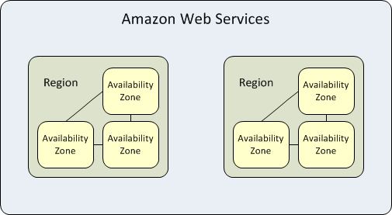
Region and Availability Zone Relation

Slide 11
BENEFITS OF CLOUD COMPUTING
Faster Deployments:
Because there’s no wait for local computing resources
Usage-based pricing:
Letting you pay only for what you use
Less financial risk:
With lower up-front investment in hardware and software
Easier upgrades:
With no on-premises software to update
Reduced need for on-premises resources:
such as servers and IT staff
Universal access
Up to date software
Choice of applications
Flexibility

Slide 12
DISADVANTAGES OF CLOUD COMPUTING
Security Issues:
Security is the major issue in cloud computing.
The cloud services implement the best security standards and industry certifications.
However, storing data on an external service providers always bears a risk.
Technical Issues:
You always need to rely on the internet to uploading/downloading and migrating.

